Slide 1
TN3125
Information and Computation
Lecture 1
1B - Introduction to information theory

Slide 2
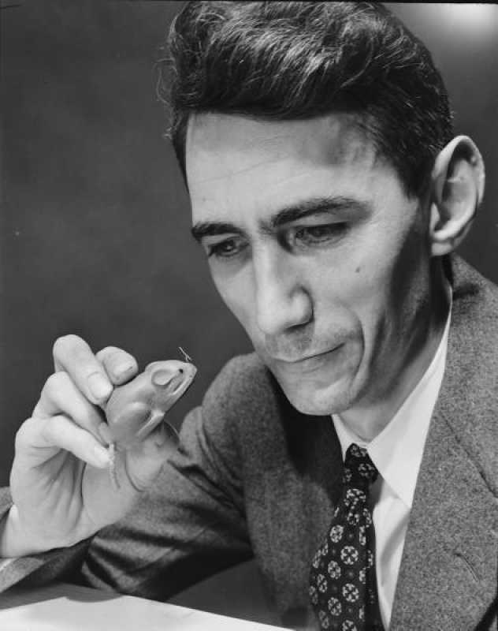

The abstract communications model
The fundamental problem of communication is that of reliably transmitting information over a channel
Examples:
A mathematical theory of communications.
Claude Shannon. Bell systems technical journal (1948)
Notes:
A channel connects

Slide 3



What is information?
0
1
Vectors by www.Vecteezy.com

Slide 4
 | Days with no rain | Days with rain
Rotterdam | 212 | 153
Atacama desert | 360 | 5
Exercise 1.1 - Let us assume that you are living in the Atacama desert where it rarely rains. You receive a 0. How much information does this message carry?

Slide 5
 | Days with no rain | Days with rain
Rotterdam | 212 | 153
Atacama desert | 360 | 5
Exercise 1.1 - Let us assume that you are living in the Atacama desert where it rarely rains. You receive a 0. How much information does this message carry?
Exercise 1.2 - Now let us assume that you live in the Netherlands where it does rain quite often, but certainly not every day. You receive a 0. Does the message contain information?

Slide 6
 | Days with no rain | Days with rain
Summer | 182 | 1
Winter | 30 | 152
Exercise 1.1 - Let us assume that you are living in the Atacama desert where it rarely rains. You receive a 0. How much information does this message carry?
Exercise 1.2 - Now let us assume that you live in the Netherlands where it does rain quite often, but certainly not every day. You receive a 0. Does the message contain information?
Exercise 1.3 - Finally, let us assume that you live in the Netherlands but (boldly) also that you are aware of the current season. You receive a 0. Does the message 0 carry the same information in summer and in winter?

Slide 7
The abstract communications model
Information
Source
Encoder
Decoder
Destination
message
message
Notes:
m → t, transmitted message
t → hat t = f(t, noise)
hat t → hat m, infers!
GOAL: m = hat m

Slide 8
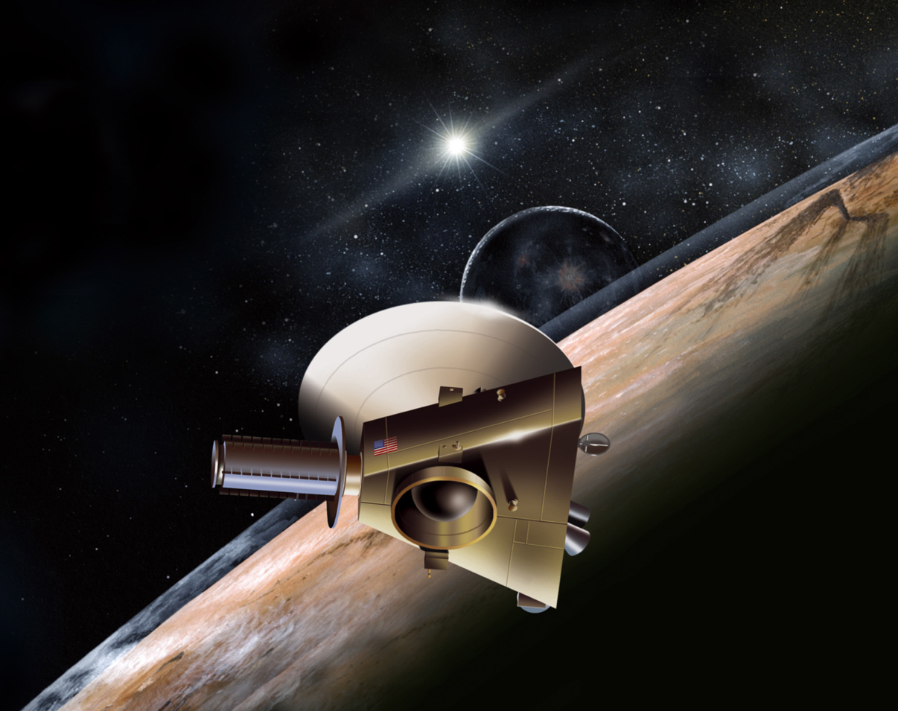

The abstract communications model
Information
Source
Encoder
Decoder
Destination
message
message

Slide 9
Lecture 1: Learning goals
Quantify the information of an event
Quantify the average information of a probability distribution
Quantify conditional information
Derive basic properties of the entropy function

Slide 10

Exercise. There are 12 coins, one of which is a counterfeit. The counterfeit is either lighter of heavier than normal coins but not of the same weight. You are given a two plate scale where you can compare weights.
Devise a scheme that detects the counterfeit coin when it is heavier
Devise a scheme that detects the counterfeit coin in the general case
Vectors by www.Vecteezy.com

Slide 11






Slide 12
Exercise. There are 12 coins, one of which is a counterfeit. The counterfeit is either lighter of heavier than normal coins but not of the same weight. You are given a two plate scale where you can compare weights.
Devise a scheme that detects the counterfeit coin when it is heavier
Devise a scheme that detects the counterfeit coin in the general case
Is it possible to detect the counterfeit coin with three weighings? And with two?
Vectors by www.Vecteezy.com

